Slide 1
SQUAT and
U.K.C.
a briefing for mariners
prepared by: Marc Van de Velde

Slide 2
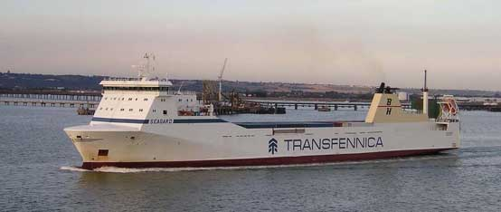
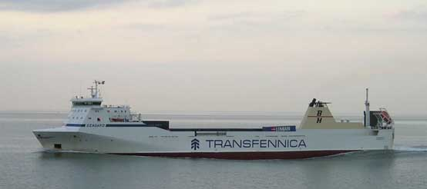
Notes:
Upper photo: ship sailing in deep water
Lower photo: same ship in shallow water; remark the bow- and sternwave, and the depressed waterlevel midships.
It’s this deperessed waterlevel midships that causes the ship to sit “deeper” in the water, but it is NOT “extra draught”.
Nevertheless: the ship will have less vertical space to the seabed.

Slide 3
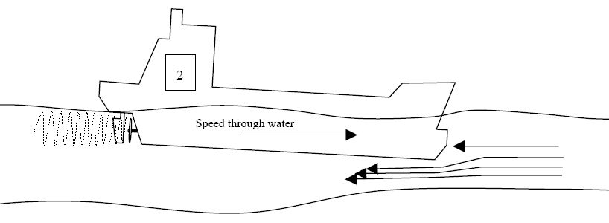
Notes:
Squat is caused by Bernouilli effect.
(But we are not going in that; captains are not supposed to be scientists.)

Slide 4
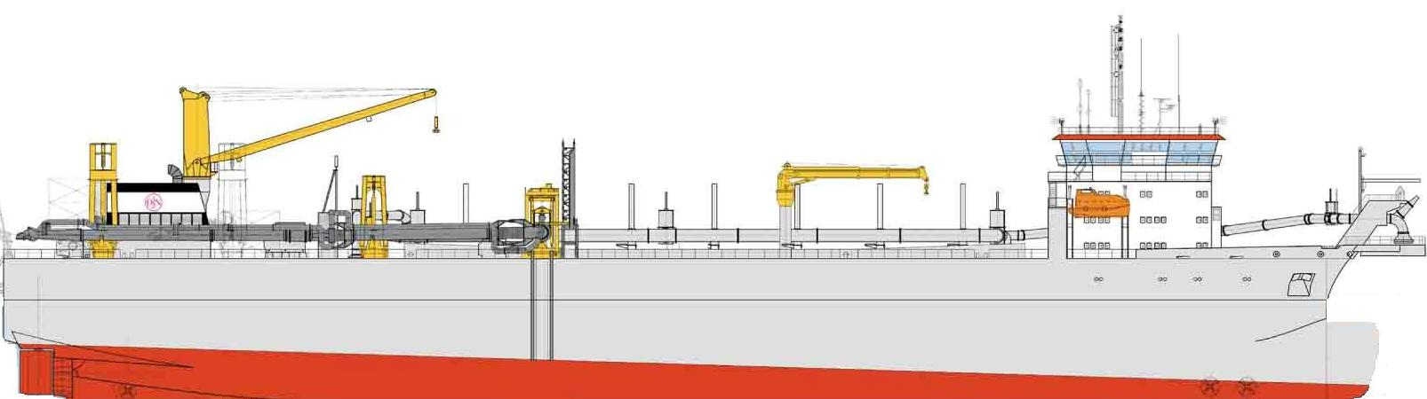
SPEED FWD.
00 knots
“STATIC” UKC
Notes:
Static Under Keel Clearance (UKC) is defined as vertical space between ship’s bottom and seabed with ship’s speed through he water = 0 knots.

Slide 5
SPEED FWD.
15 knots
Notes:
Ship’s speed 15 knots

Slide 6
SPEED FWD.
15 knots
Notes:
And this is what happens:
Wave pattern around the ship changes
Ship will sit closer to the seabed
And trim forward (in this case; because ship is even keel)

Slide 7
SPEED FWD.
15 knots
SPEED FWD.
13 knots
“DYNAMIC” UKC or
“NETT” UKC
Notes:
Ship “sinking” bodily in the water,
and trimming forward,
Showing “Nett” or “Dynamic” UKC

Slide 8
SIGNS OF SHALLOW WATER
1. Changing wave pattern around ship

Slide 9
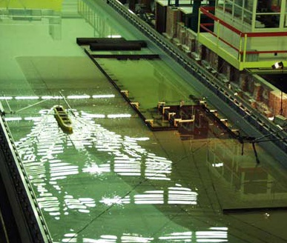
Notes:
Changing wave pattern in shallow water (model in towing tank)

Slide 10
SIGNS OF SHALLOW WATER
1. Changing wave pattern around ship
2. Vibrations

Slide 11
SIGNS OF SHALLOW WATER
1. Changing wave pattern around ship
2. Vibrations
3. Ship slows down

Slide 12
Notes:
Squat is caused by Bernouilli effect.
The water under the keel speeds up,
causing extra friction,
causing a loss of ship’s speed.

Slide 13
SIGNS OF SHALLOW WATER
1. Changing wave pattern around ship
2. Vibrations
3. Ship slows down
4. Trim changes

Slide 14
Trim aft:
with squat, ship trims more aft
SPEED FWD.
13 knots
Notes:
Ship trimmed aft:
ship will trim more aft in shallow water.

Slide 15
Even keel:
with squat, ship trims forward
SPEED FWD.
13 knots
Notes:
Ship trimmed even keel:
will trim more forward in shallow water, if Cb > 0.7 (all JDN vessels !).

Slide 16
Trim foward:
with squat, ship trims more forward
SPEED FWD.
13 knots
Notes:
Ship trimmed forward:
ship will trim more forward in shallow water.

Slide 17
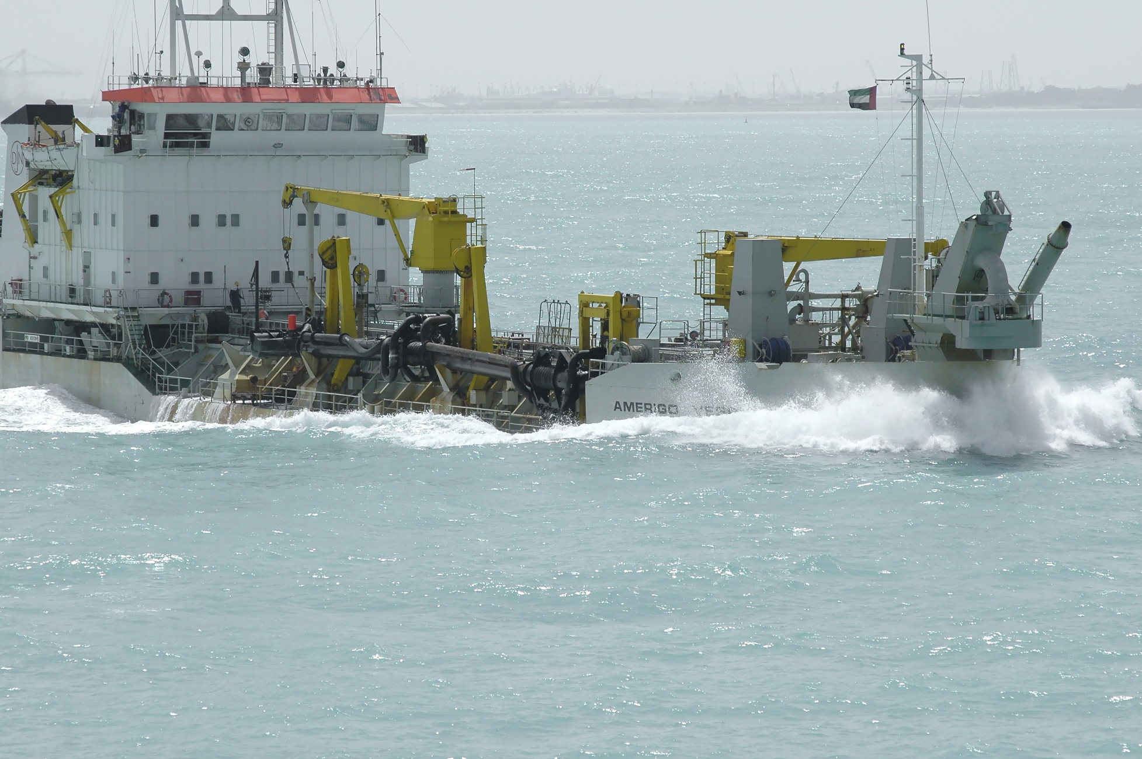
Notes:
Amerigo Vespucci trimmed forward because of squat effect,
in shallow water inside Palm II.

Slide 18
SIGNS OF SQUAT
1. Changing wave pattern around ship
2. Vibrations
3. Ship slows down
4. Trim changes
5. Loss of manoeuvrability, steerage,….
Notes:
Everybody knows this from experience ?
Ship will react sluggish to rudder commands,
Course stability is affected,
Etc…

Slide 19
SIGNS OF SQUAT
1. Changing wave pattern around ship
2. Vibrations
3. Ship slows down
4. Trim changes
5. Loss of manoeuvrability, steerage,….
6. Turning circle diameter x2, … x3…

Slide 20
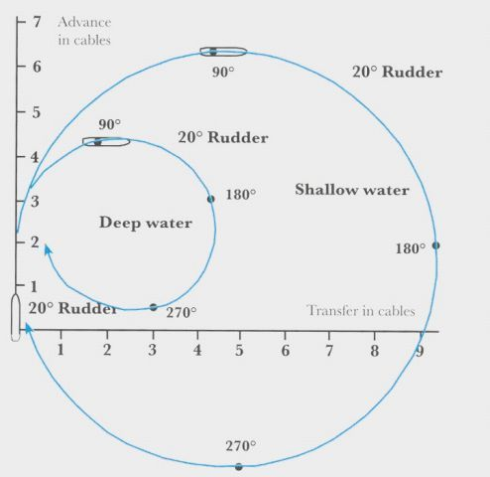
Notes:
In shallow water: tactical diameter enlarges with factor 2 or 3…
We’ll show an elaborate example of this…

Slide 21
SQUAT FORMULAE in focus
Notes:
A closer look to squat formulae, time for the boring stuff.

Slide 22
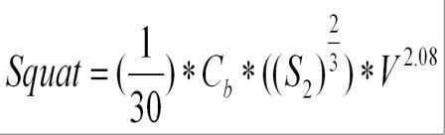
Notes:
Just a random squat formula for ships in restricted channels….

Slide 23
V = ship speed (knots)
Cb= block coefficient
S2= velocity return factor = S/(1-S)
S= blockage factor = As/Ac
As= midships cross sectional area (m2)
Ac= cannel cross sectional area (m2)

Slide 24
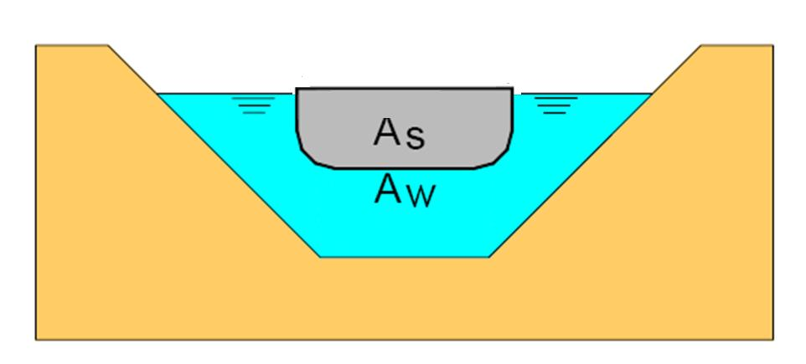
S2= velocity return factor = S/(1-S)
S= blockage factor = As/Aw
As= midships cross sectional area (m2)
AW= channel cross sectional area (m2)

Slide 25
Cb= block coefficient

Slide 26
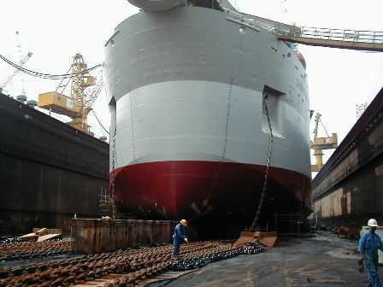
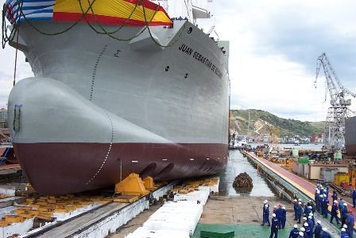
Cb (this ship) > Cb (this ship)
Notes:
Left “Gerardus Mercator” , right “Juan Sebastian De Elcano”.
Blockcoefficient Cb (GM) > Cb (Ju)

Slide 27
V = ship speed (knots)
This is : ship’s speed through the water !
Example:
SpeedOverGround = 10 knots + 4 knots countercurrent knots = speed 14 knots

Slide 28
Example: Gerardus Mercator
for V= 15 knots -> squat = 1.8 m
for V= 10 knots -> squat = 0.8 m

Slide 29
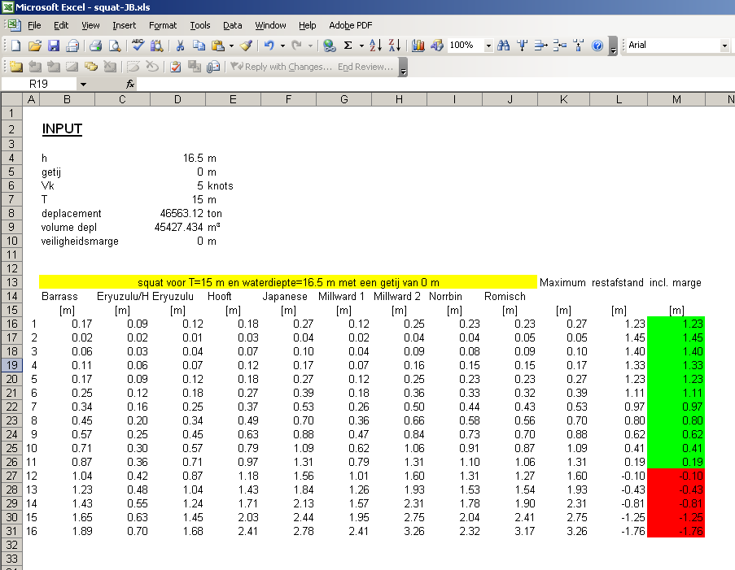
Notes:
Different squat formulae …..

Slide 30
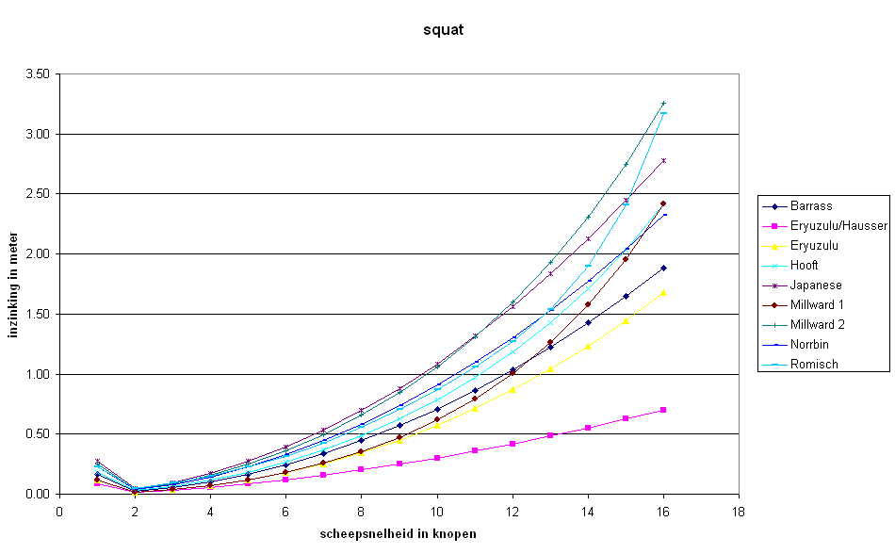
Empirical formulae
Notes:
…. give different results.

Slide 31
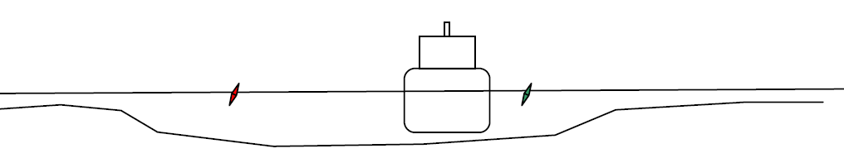
Situations
Notes:
Three different situatons:
1. Open unrestricted shallow water
2. Restricted channel
3. Channel with raised banks

Slide 32
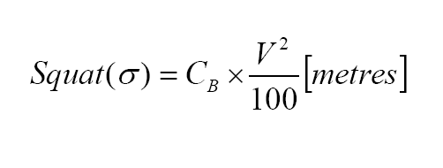
Situations
Formula Dr. Barass
Notes:
Open unrestricted shallow water + formula

Slide 33
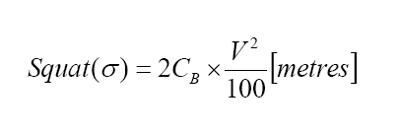
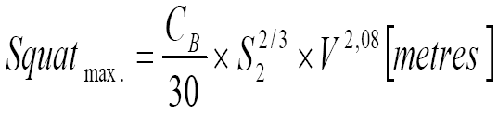
Situations
Or better:
Formulae Dr. Barass
Notes:
Restricted channel: two formulae, the latter is more correct, allows for relation of midships cross sectional area and channel cross section.
These are only a few of the possible formulae for this situation !

Slide 34
Situations
Formula Dr. Barass
Notes:
Channel with raised banks +formula.
This is one of a few possible formulae for this situation !

Slide 35
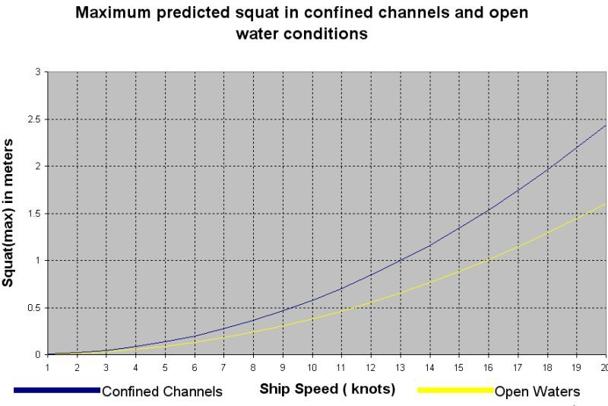
Notes:
Ship in unrestricted shallow water or in confined channel: different squat values.

Slide 36
U.K.C.
Under Keel Clearance
Static UKC (with ship’s speed =0)
Nett UKC (with sailing ship)

Slide 37
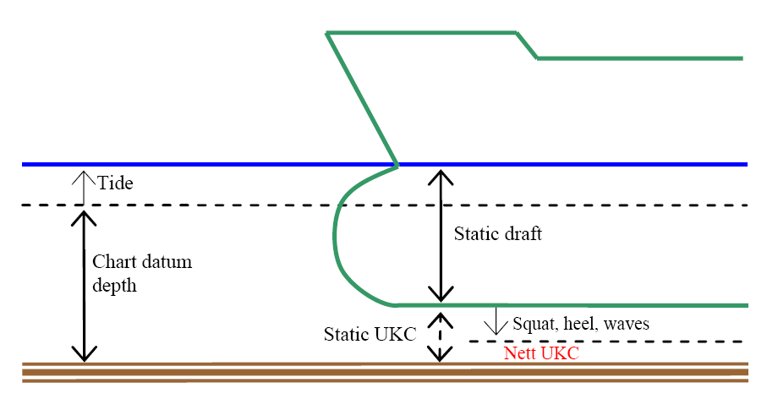
Notes:
Nett UKC = Static UKC – squat – heel - waves

Slide 38
Heel
New draft = ½ beam sin(list) + old draft. Cos(list)
Notes:
Heel (list) with formula showing effect on UKC.

Slide 39
What is a safe NETT UKC ?
According textbooks on navigation:
1.1 x to 1.25 x largest draught
Example:
12m draught,
safe UKC = 1.2 to 3 meter
Notes:
What is a safe UKC ?
According older textbooks: 1.1to 1.25 times the ship’s draught.
These textbooks often allowed for a good manoeuvrability of the ship, and did not focus on squat formulae.

Slide 40
What is a safe NETT UKC ?
According PIANC
 | PIANC www.pianc.org
 | -
Muddy bottom | 0.3 m (*)
Sandy bottom | 0.5
Rocky bottom | 1m
(*) muddy bottom: in some cases a negative UKC is possible !
Notes:
Newer insights:
PIANC gives values according nature of the seabed, from 0.3 to 1 meter.

Slide 41
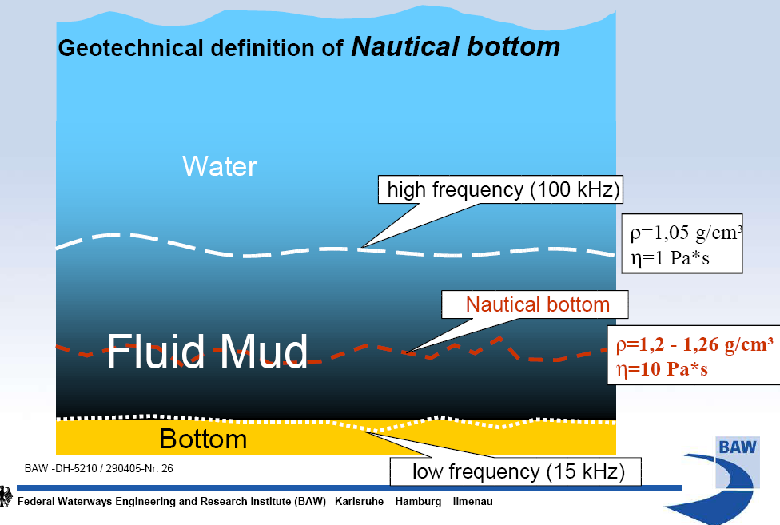
Notes:
Muddy bottom: ships can sail through mud layers, with negative UKC.
But this is specialized stuff, we don’t go deeper in that.

Slide 42
Notes:
We can put this formula (or any other squat formula) to good use in shallow water conditions ; affecting squat with ship’s speed to optimalise ship’s draught.
This is especially useful in tide bound work.

Slide 43
What does it takes ?
Exact draught measurement ?
2. Online real-time tidal heights onboard ?
3. Heel measurement ?
4. Estimate of ship’s motion in waves ?
5. Exact survey of shallow route ! ! !
Notes:
…. and this is what it takes to optimalise that …

Slide 44
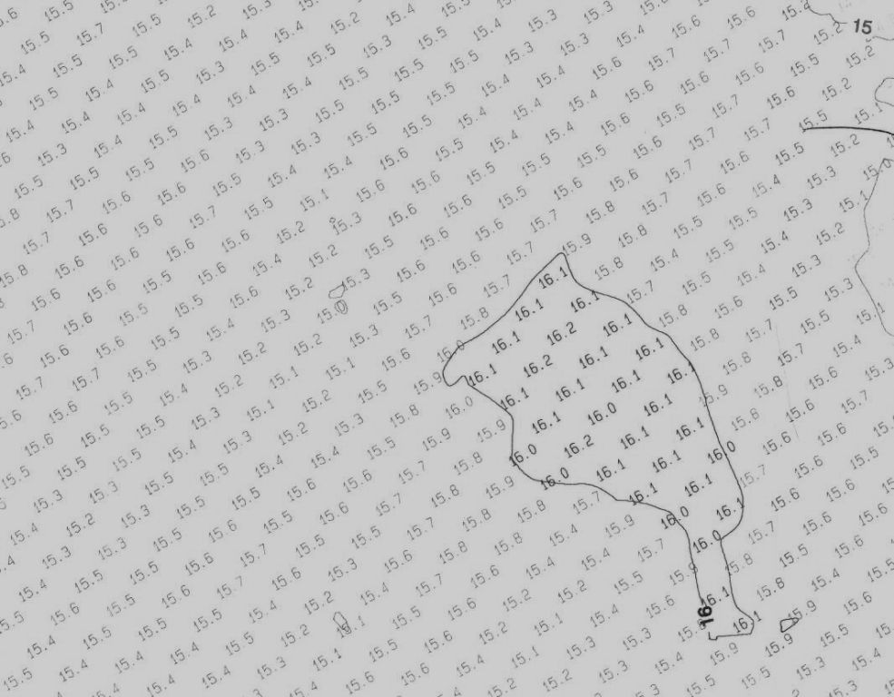
? ? ? ? ? ? ? ? ? ? ? ? ? ? ? ? ? ? ? ? ? ? ? ? ? ? ? ? ? ? ? ? ? ? ? ? ? ? ? ? ? ? ? ? ? ? ? ? ? ? ? ? ? ? ? ? ? ? ? ? ? ? ? ? ? ?
Notes:
Be critical to survey-charts, nautical charts, etc…

Slide 45
Questions over a surveychart:
Is this multibeam or singlebeam survey ?
2. Did the multibeam cover the whole area ?
3. What was the data interpolation setting ?
4. How old is this data ?
5. What is the source of this data ?
Notes:
Questions to be asked while examining a survey chart.
Advantages of multibeam: 100% coverage of the area is possible: important on rocky bottom.
Even with multibeam: some area may not be covered.
Data ca be interpolated; more on that later.
Old data on rocky bottom is ok. But data of 3 months old on sandy bottom, especially in rivers, will not reflect actual depths ! Sandy river beds can change quickly. Care must be taken also when other dredgers are at work, dredging, discharging, spoil from discharge area, dumping, etc…
Is this JDN survey data ? Is this data from a third party ? How much control do we have on the quality of the data ? What tidal data has been used to correct for tidal heights (astronomical or realtime tidal heights) ? Has the data been manipulated for other purposes ?
Personally: I am very suspicious when I look at a survey chart.

Slide 46
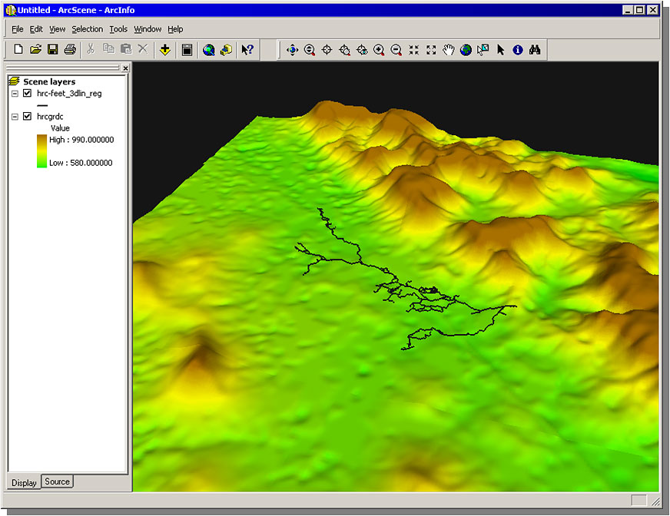
Notes:
Interpolation of raw survey data;
Example: a high spot…

Slide 47
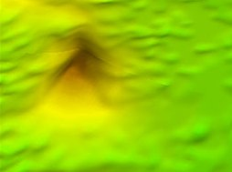
Mean value for his area:
12.9 m
Highest value: 12.5 m
Lowest value: 13.3 m
Notes:
…. This high spot in more detail….
The survey chart will show one value, representing a certain area, for example 10 m2.
This value is normally the mean of all the raw data collected I that area.
Standard used is “mean” values, but as a captain, we are interested in “highest” values, representing the most shallowest spots !

Slide 48
FIRST EXAMPLE
Gerardus Mercator in Palm II, 2006

Slide 49
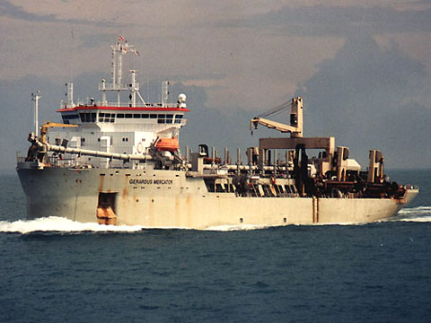
Design max. depth 12.4 m
Max. draught 12 m
Notes:
Minmum waterdepth Palm II : 12.4 m (in Trailer Access Channel)
Draught GM: 12 meter
Tidal height range 0-2 meter.
-> GM is tide restricted most of the time.

Slide 50
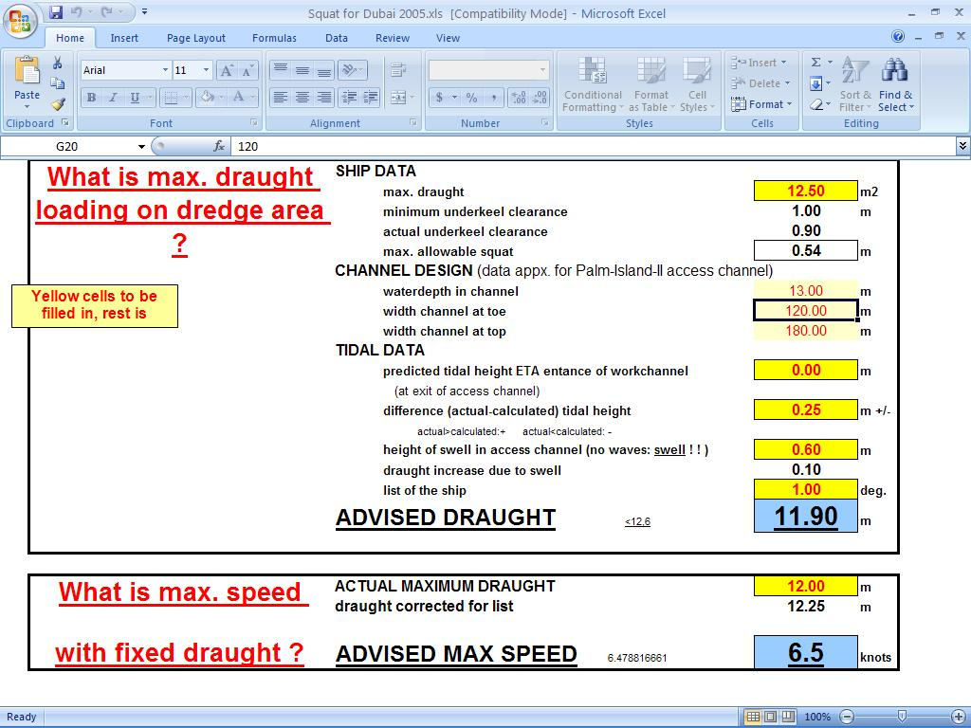
Notes:
This problem was solved with a spreadsheet, containing squat formulae.
Question 1: chief mate is o the dredging area; how deep can he load the vessel ?
Question 2: ship is loaded, with this given draught, what is max. safe speed for this draught and a fixed nett UKC ?

Slide 51
SECOND EXAMPLE
Cristobal Colon in Cuxhaven, 2010

Slide 52
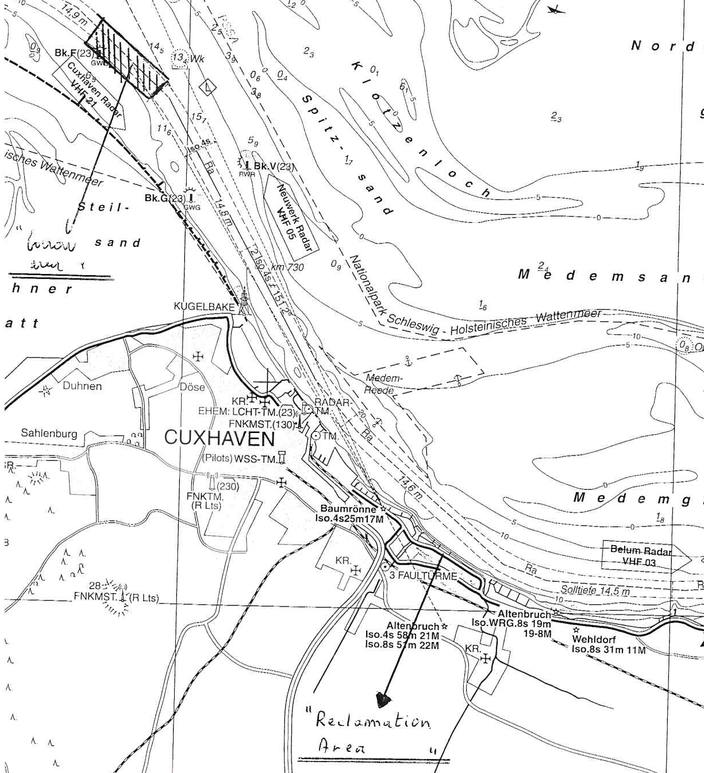
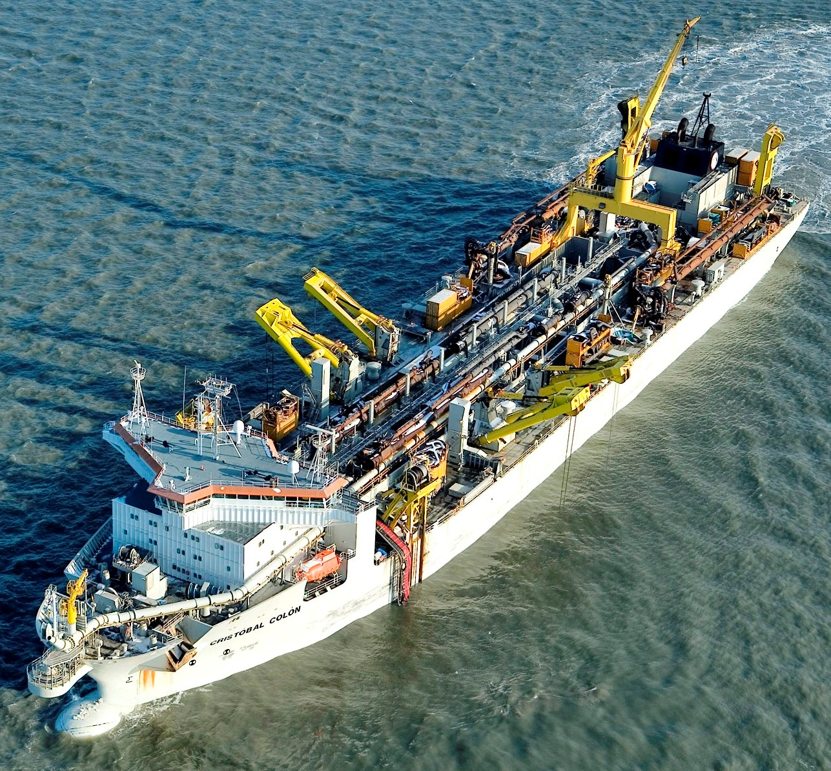
Max. draught 15+ m
Channel depth 14.6 m
Notes:
Dredge area seawards, discharge rea off Cuxhaven.
Channel depth 14.6 meter
Max draught CR 15+ meter.
CR is continuously tide-restricted.

Slide 53
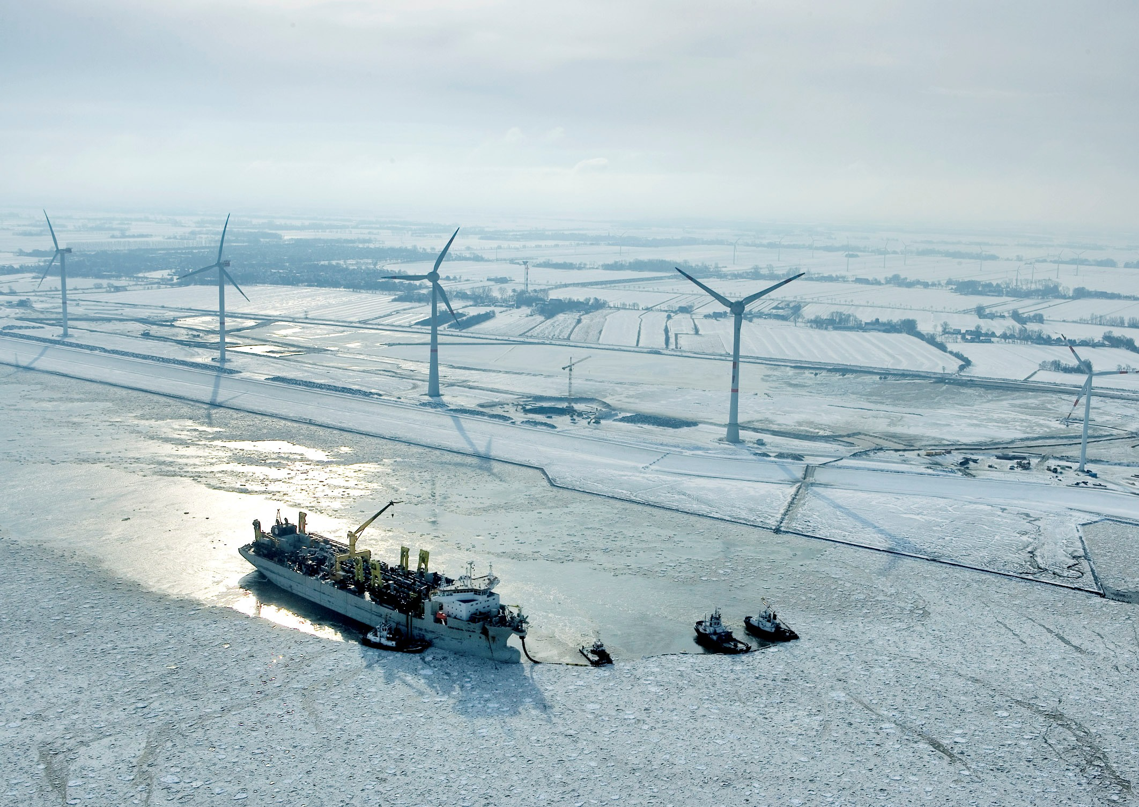

Slide 54
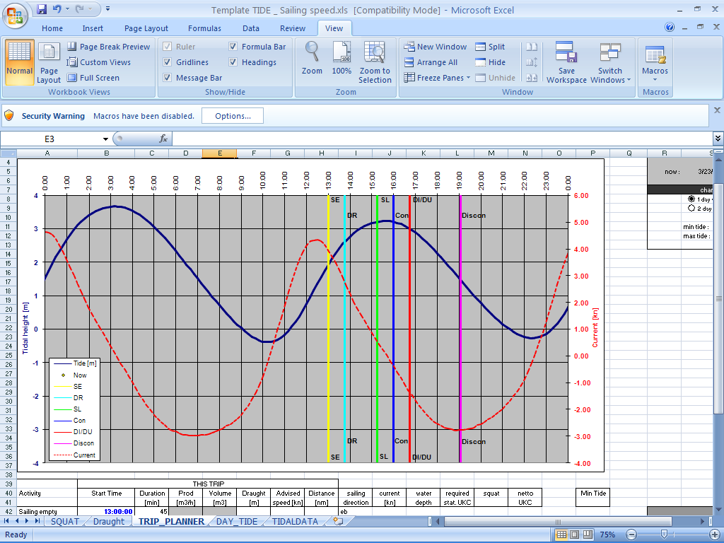
Notes:
Spreadsheet to manage (read: optimalize) cyclus of Cristobal Colon versus tides and currents

Slide 55
Why all this fuzz ?

Slide 56
An “error” in draught of 50cm…
50 cm less draught x 45t/cm = 2250 ton
=
1000 m3 sand per trip less
=
7% of daily production (!)
(example Gerardus Mercator)

Slide 57
… or …
a much higher risk of grounding….

Slide 58
CONCLUSION
Squat can be estimated and controlled…
2. … to maintain a tight –but safe- UKC…
3. …and optimize load, cycle production.
IF
all relevant parameters are measured / known

Slide 59
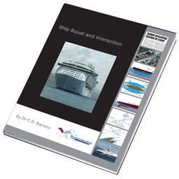
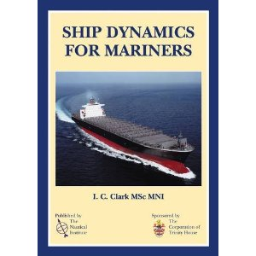
References
http://www.ship-squat.com/
Notes:
References and recommended reading (click the books for links).

Slide 60
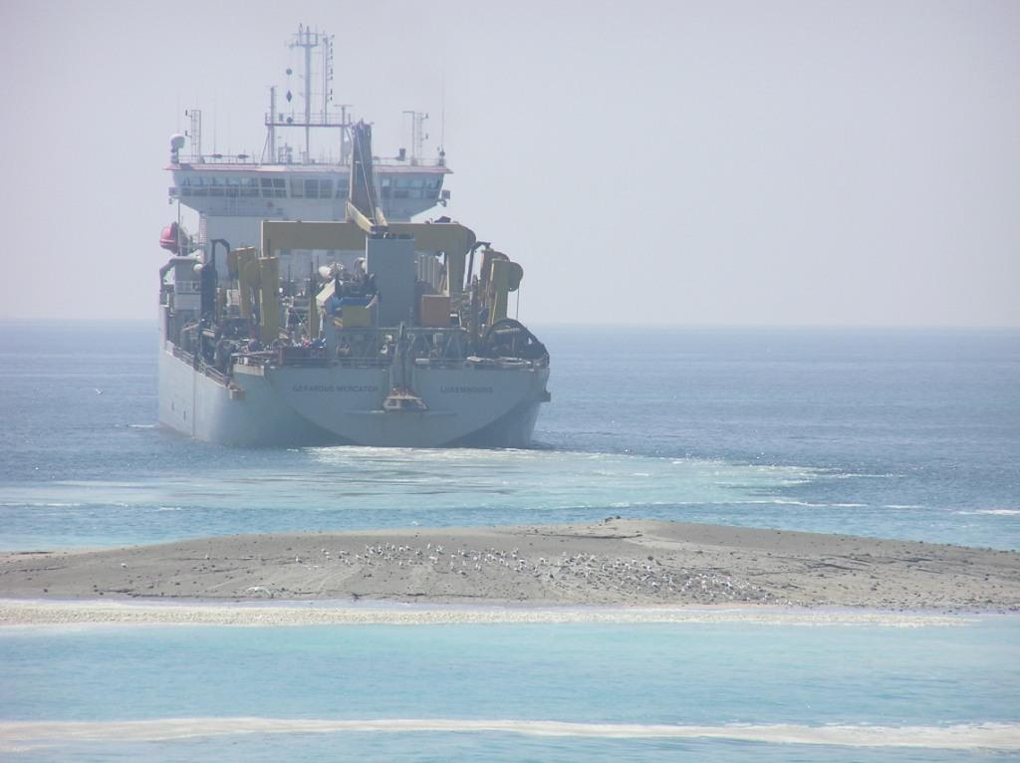
www.theArtofDredging.com

